Slide 1

RUSA Recovery Fund Section 3 Data Analytics
By Fauzan Amjad | RUSA COVID – 19 Response and Recovery Department

Slide 2
Section 3A
Percentage of applications categorized by expense categories (food, rent, etc.)

Slide 4
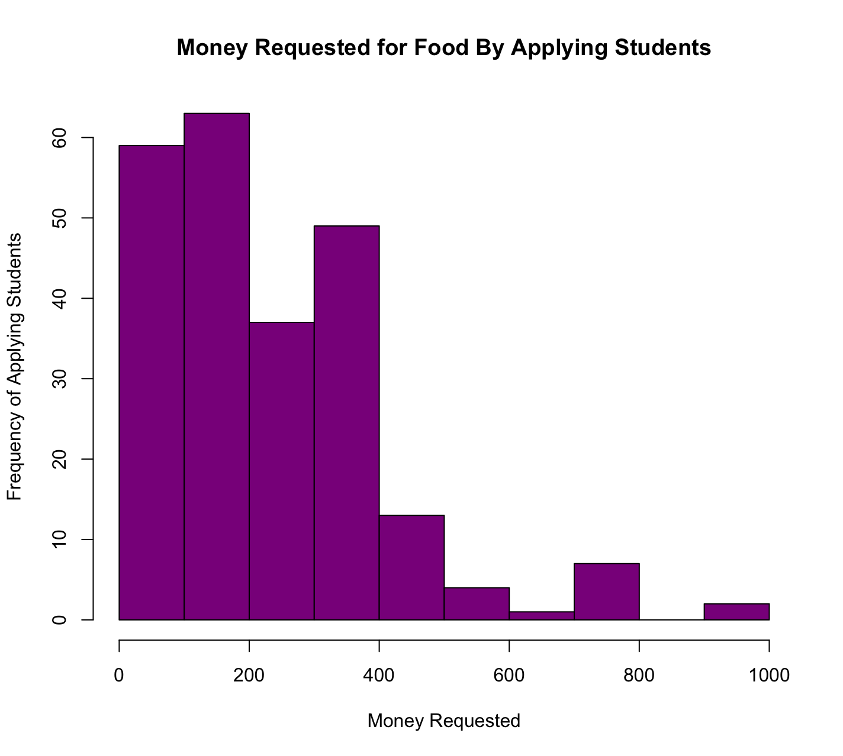

Slide 6
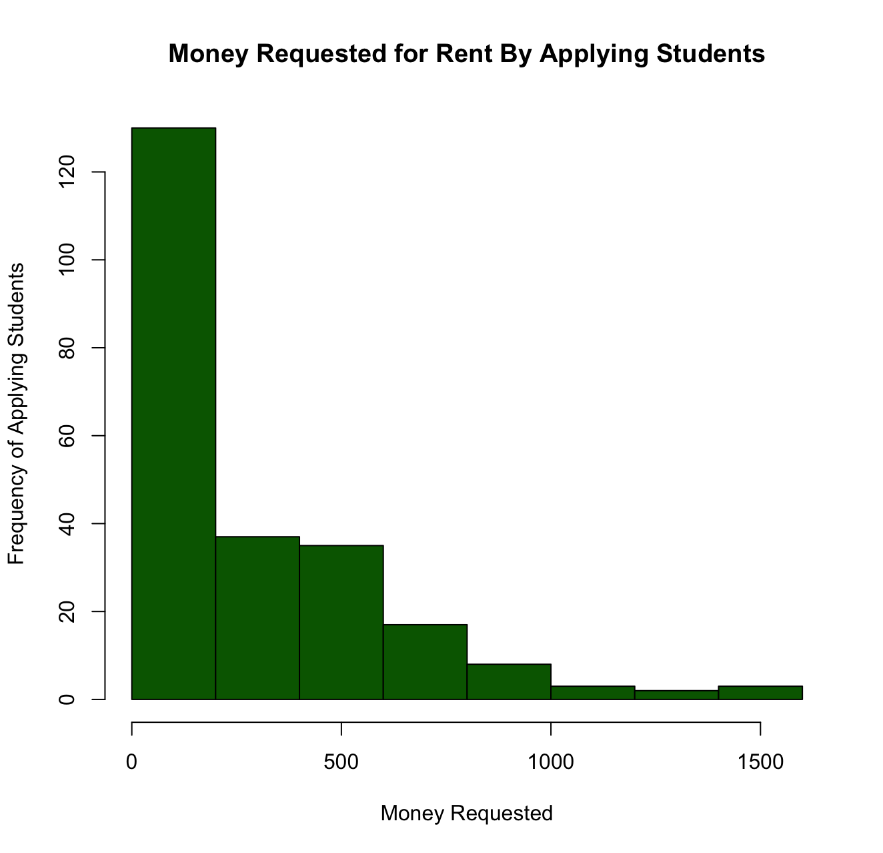

Slide 8
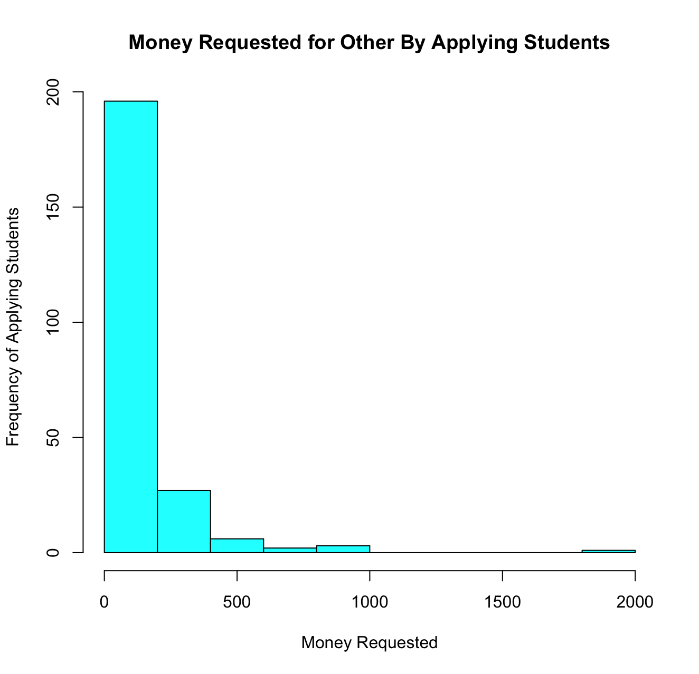

Slide 9
Section 3B
Percentage of APPROVED applications categorized by expense categories

Slide 11
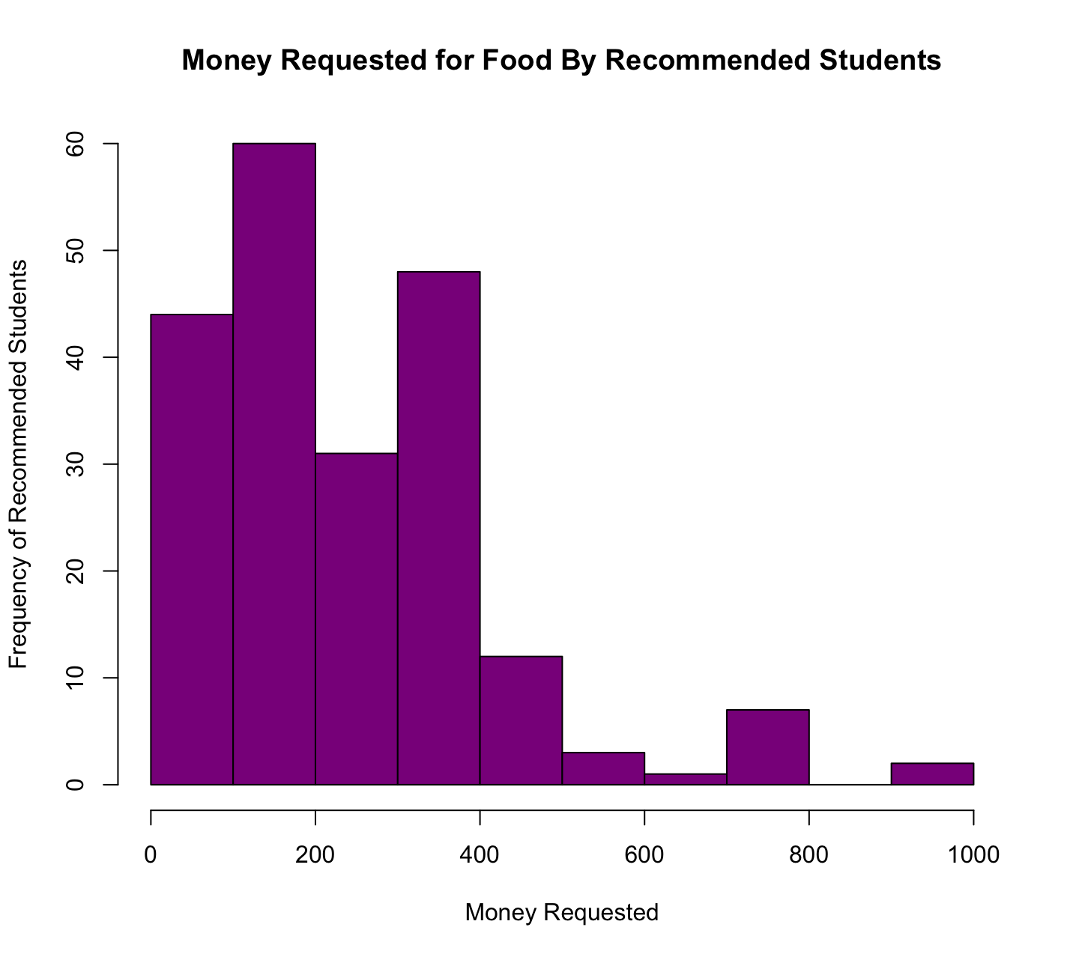

Slide 13
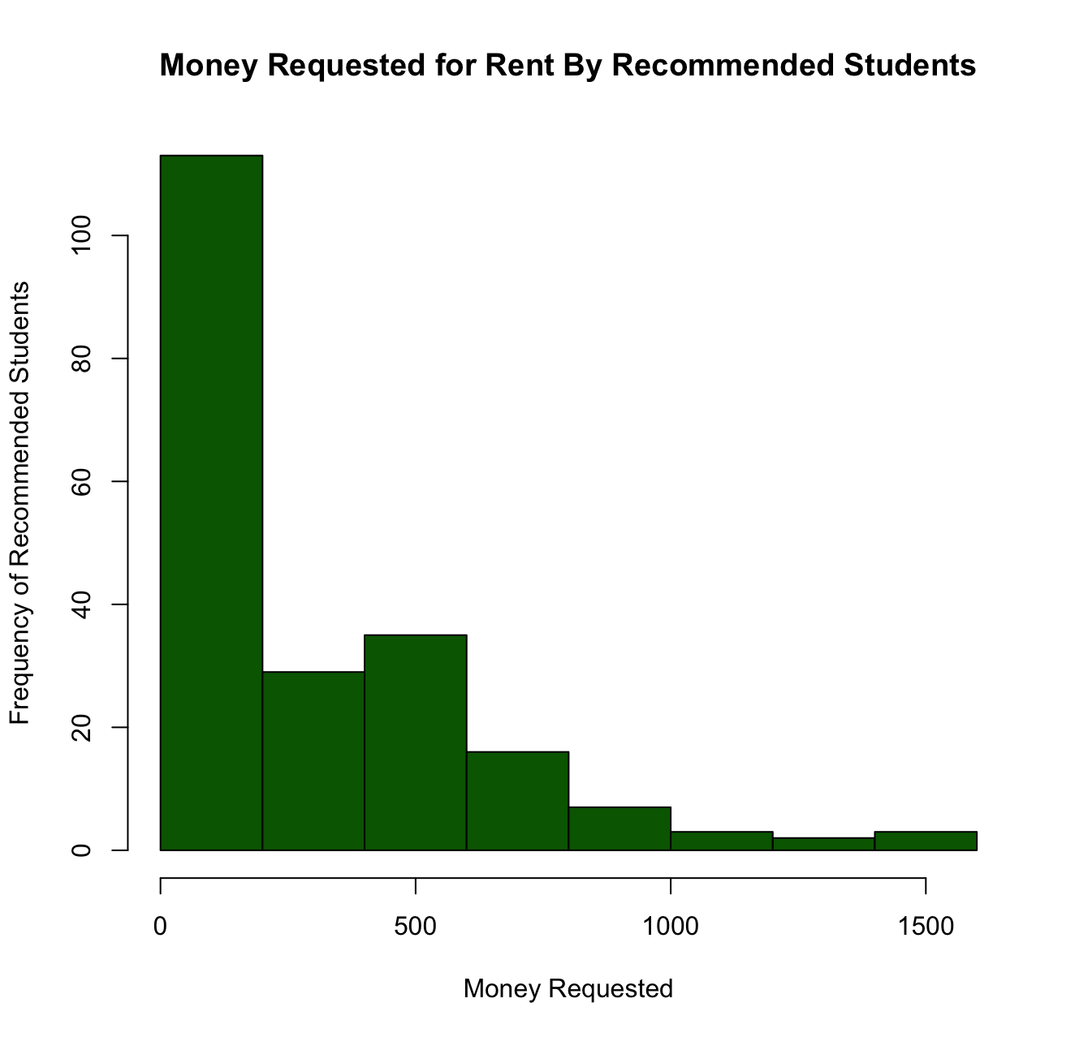

Slide 15
